Slide 1
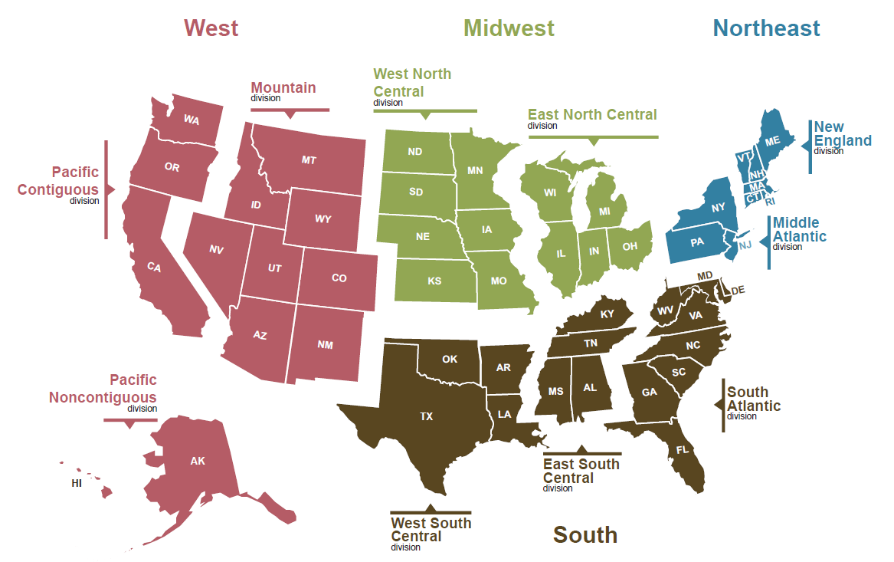
Travel Project
Betsy King, Mike Gleixner, Megan Moroney

Slide 2
Project Overview - Data
List of Cities – 153 US cities
List of US cites ranked by population – CSV from US Census, keeping about 130 cities from that list
Added additional cities with lower populations but top vacation destinations like Hilton Head, Key West, etc.
Web Scraping
Scraped city facts, weather data and images of the cities from Wikipedia
Kaggle Data - museums, zoos, aquariums CSVs
Recreation.gov – US Government Agencies – campsites, facilities, tours CSVs
Google Places API – hotels and restaurants JSON data

Slide 3
Project Overview – Code & Tools
Javascript – library Highchart was used to make graphs with the weather data that was scraped.
Python – pandas and numpy
Scraping data and images from Wikipedia
Google Places API to get JSON data
PostgreSQL – storage of data in our database
Python/Flask to power RESTful API.
JavaScript, HTML & CSS to render maps and design the app
Mapbox – display maps
Leaflet – adding markers to maps

Slide 4
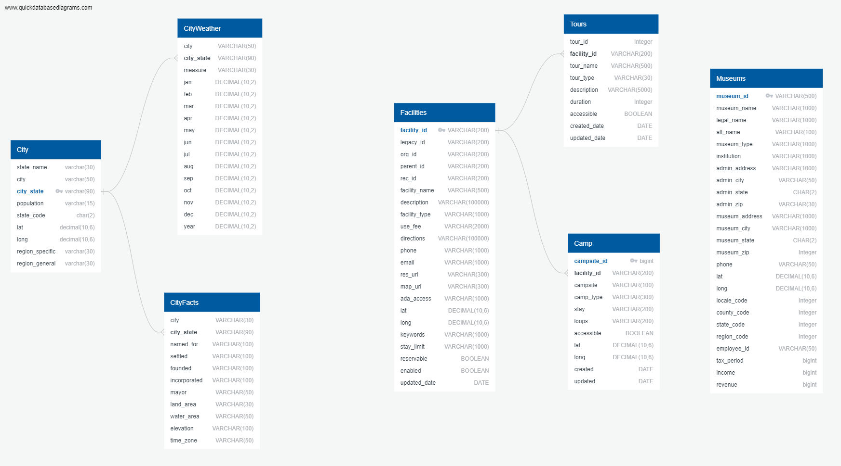

Slide 5
